Slide 1

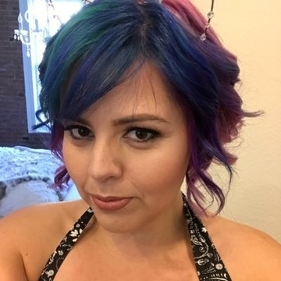
Container 101 - Getting Up and Running With Docker Containers
Michael Irwin
Application Architect, Virginia Tech
Docker Captain, Community Leader
@mikesir87
Ell Marquez
Technical Evangelist at Linux Academy
@ell_o_punk

Slide 2
Agenda
Why Containers?
Container and Image Basics
Build, ship, and run an app
Diving deeper into images
“Capture the Flag!”
Docker Compose and multi-service apps
Hands-on with Compose
Orchestration teaser

Slide 3
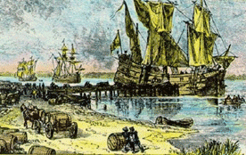
A long, long time ago...
When shipping was done mostly between land/sea…
Goods were packaged mostly in barrels, crates, and sacks
Ships often spent more time in dock than on the sea because of time it took to load/unload
Chance of loss/theft was very high
Credit: http://www.worldshipping.org/about-the-industry/history-of-containerization/before-container-shipping
Notes:
http://www.worldshipping.org/about-the-industry/history-of-containerization/before-container-shipping

Slide 4
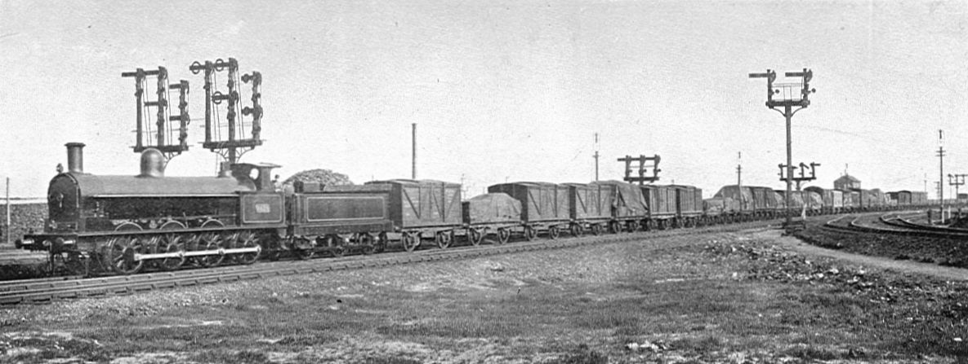
Industrial Revolution
When rail became more common…
Goods frequently went from ship to train, train to train, and train to ship
Inadequacies of load/unload processes compounded
A better shipping practice was needed
Credit: https://en.wikipedia.org/wiki/Rail_freight_in_Great_Britain

Slide 5
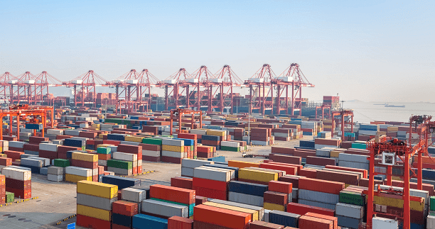
The Shipping Container
With the shipping container…
Goods producers can simply load a box with whatever they want to ship
The shipping industry can focus around a standardized box
Goods can be moved much more efficiently
Chance of loss/theft plummeted
Notes:
The same box can be used for sea, trucking, freight, storage, and more

Slide 6
Software = Shipping?

Slide 7
Yes! We ship software!
Deploying software has always been painful, but was manageable
Now, we want to adapt to users and to changing requirements
The faster pace of shipping software highlights the pain points
Especially true in microservice-based applications
Notes:
Just as a shipping container, with a container image, we pack whatever we want into it and ship it around
If you don’t think this is actually a problem...

Slide 8

Welcome! Glad to have you on the team!
Clone the repo, use README to install env, and update docs as needed. Good luck!
Notes:
A deployment is Code + Configuration + Environment

Slide 9
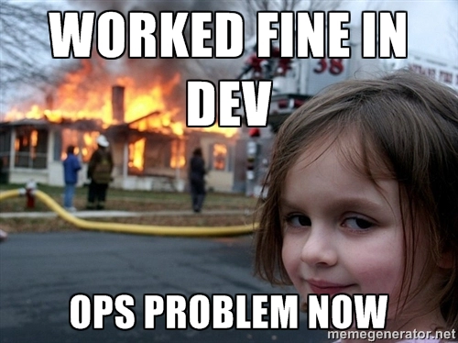
Notes:
Ops Problem now!
Wouldn’t it be nice to handle code + configuration + environment in a standardized way?

Slide 10
What is an image?
A fully self-contained “thing” that contains everything an app needs to run
Application source code
All runtime dependencies, config files, and binaries
At the end of the day, it’s basically just a transportable file system
Notes:
A building block we can use to deploy applications in a repeatable way.

Slide 11
Important Note:
Images are STATELESS and IMMUTABLE
Notes:
Emphasis that we’re still talking images here, as containers obviously aren’t stateless/immutable.
Helps with repeatability and prevents environment creep -> entropy

Slide 12
Creating Images
Best practice is to use a Dockerfile
A text file that contains a script used to create an image
Allows various commands, including:
FROM - specify the parent image (almost always the first command)
COPY - copy files from the host into the image
RUN - run a command using binaries inside the container (install services, etc.)
CMD - specify the default command (if one not specified in parent image)

Slide 13
Sharing Images
When building an image, it only exists on the building machine
To share, have to push to a registry
Docker Hub is the default registry
Many other third-party offerings available too
Once shared, others can pull the image

Slide 14
What’s a container then?
While a container looks like a VM, it isn’t!
A container is JUST another process on the machine
It uses namespaces and control groups (cgroups) to provide isolation
Namespaces include network, process, user, IPC, mount, and others
Notes:
Strongly emphasize that a container is JUST another process on the machine. No more. No less.
Namespaces - isolate processes
Mount (mnt)
Process ID (pid)
Network (net)
Inter-process Communication (IPC)
UTS (hostname and domain name)
User ID (user)
Cgroups (control groups) - limit system resources a container can consume

Slide 15
Containers vs VMs
App 1
App 2
App 3
Bins/Libs
Bins/Libs
Bins/Libs
Guest OS
Guest OS
Guest OS
App 1
App 2
App 3
Docker Daemon
Hypervisor
Bins/Libs
Bins/Libs
Bins/Libs
Host Operating System
Operating System
Infrastructure
Infrastructure
Notes:
Start with how we isolate apps, using the VM stack
(click)
Containers help provide some of the same levels of isolation, but highlighting the fact that each of the containers are just processes on the machine.
In fact, the Docker daemon itself is just another process, but used to setup the isolation between apps
Each “stack” for a container consists of the image filesystem, isolated from each other

Slide 16
Hands-on Time!
Time to build your first image!
Go to https://github.com/mikesir87/dceu-2018-workshop
Open the 1-building-first-image folder
Follow the README.md
You have 10 minutes to work on it
When done, put your post-it note on the back of your laptop

Slide 17
Image Layering
Images are composed of layers of filesystem changes
Each layer can add or remove from the previous layer
Each layer’s filesystem changes are stored as a single tar file

Slide 18
Layer contents
When the layers are unioned together, they provide a full filesystem
Each layer can add files as needed
Files in “higher” layers replace the same file in “lower” layers
The container uses the “merged” view
file1
file2
file3
file4
file5
Merged
file2
file5
Layer 2
file1
file2
file3
file4
Layer 1

Slide 19
What about deleted files?
Deleted files are represented in a layer as a “whiteout” file
Whiteout files are only used by the filesystem driver and not visible in the merged filesystem
file1
file2
file3
file5
Merged
.wh.file4
Layer 3
file2
file5
Layer 2
file1
file2
file3
file4
Layer 1
Notes:
Important thing to note here is that the contents of file4 are being transported with the layer, but then being removed from a higher layer (we’ll see an example of this in the demo)
Remember that each of these image layers is immutable

Slide 20
Clean up as you go
Don’t wait until the end of the Dockerfile to “clean” the container
Chain RUN commands together to clean things as you go
FROM ubuntu
RUN apt-get update
RUN apt-get install -y python python-pip
RUN pip install awscli
RUN apt-get autoremove --purge -y python-pip
Net change of image size from 517MB to 172MB (67% reduction)
FROM ubuntu
RUN apt-get update && \
apt-get install -y python python-pip && \
pip install awscli && \
apt-get autoremove --purge -y python-pip && \
rm -rf /var/lib/apt/lists/*

Slide 21
Keep images tight and focused
Only install the dependencies/tools/packages that are necessary
Use multi-stage builds to separate buildtime and runtime dependencies
Additional sessions
Tue @ 17:45 - 264079 - Tips and Tricks for Optimizing your Docker Container for Size and Security
Wed @ 12:00 - 244258 - Supercharged Docker Build with BuildKit

Slide 22
Hands-on Time!
Time for a “Capture the Flag!”
Go to https://github.com/mikesir87/dceu-2018-workshop
Open the 2-image-dive folder
Follow the README.md
You have 10 minutes
When done, put your post-it note on the back of your laptop

Slide 23
Volumes
Volumes provide the ability to persist/supply data in containers
Bind mount volumes
You choose where to persist the data
Example: -v /docker-data/mysql:/var/lib/mysql
Named volumes
Let Docker choose where to persist the data
Example: -v mysql-data:/var/lib/mysql

Slide 24


Slide 25
Introducing Docker Compose
Makes defining and running multi-container apps super easy
Uses a YAML file for configuration (docker-compose.yml)
Often included in project source repo at the root of the project
With a single command, all containers/services for an app start
Tool is bundled with Docker Desktop

Slide 26
Docker Compose Versions
Version 1 (no version declaration)
Supports containers, volumes, but no networking
Version 2.x
Added networking support
Version 3.x
Added support for Swarm services/deployments

Slide 27
Building our YAML file
> docker container run -p 80:80 -v $(pwd)/src:/var/www/html php:7-apache
Start with a version
Usually, it’s best to just use the latest supported version
version: "3.7"

Slide 28
Building our YAML file
> docker container run -p 80:80 -v $(pwd)/src:/var/www/html php:7-apache
Next, define our services (the apps we want to run)
We’ll name this first one app
version: "3.7"
services:
app:

Slide 29
Building our YAML file
> docker container run -p 80:80 -v $(pwd)/src:/var/www/html php:7-apache
Now, we specify the image that we want to use for the service
version: "3.7"
services:
app:
image: php:7-apache

Slide 30
Building our YAML file
> docker container run -p 80:80 -v $(pwd)/src:/var/www/html php:7-apache
Let’s move our port mapping by specifying the ports. The order is host:port. There is a longer, more descriptive way to write this too.
version: "3.7"
services:
app:
image: php:7-apache
ports:
- 80:80

Slide 31
Building our YAML file
> docker container run -p 80:80 -v $(pwd)/src:/var/www/html php:7-apache
Finally, let’s move our volume mapping. Fortunately, you can use relative paths in Compose
version: "3.7"
services:
app:
image: php:7-apache
ports:
- 80:80
volumes:
- ./src:/var/www/html

Slide 32
Building our YAML file
> docker container run -p 80:80 -v $(pwd)/src:/var/www/html php:7-apache
And we’re done!
version: "3.7"
services:
app:
image: php:7-apache
ports:
- 80:80
volumes:
- ./src:/var/www/html

Slide 33
Docker Compose commands
There are lots of subcommands, but the most common are:
up - start up all services, networks, volumes, etc.
down - stop and remove all containers, networks, and volumes
logs - view logs from all services

Slide 34
Adding more services
Rarely do apps live on their own with no dependencies
Apps rely on databases, caches, message queues, and more!
Docker Compose makes it easy to hook together many services
All services (by default) on an isolated network that allows them to talk to each other, but no other containers on the same host
Additional sessions to learn more about networking
Tue @ 12:00 - 252709 - Docker Container Networking
Wed @ 12:00 - 250876 - Tips and Tricks of the Docker Captains

Slide 35
Adding another service
version: "3.7"
services:
app:
image: php:7-apache
ports:
- 80:80
volumes:
- ./src:/var/www/html
mysql:
We’re going to add a simple database service to the Compose stack
Start off by adding a new service. We’ll call it, simply, mysql

Slide 36
Adding another service
version: "3.7"
services:
app:
image: php:7-apache
ports:
- 80:80
volumes:
- ./src:/var/www/html
mysql:
image: mysql:5.7
Let’s specify the image. We’ll use the official mysql image.

Slide 37
Adding another service
version: "3.7"
services:
app:
image: php:7-apache
ports:
- 80:80
volumes:
- ./src:/var/www/html
mysql:
image: mysql:5.7
environment:
MYSQL_ROOT_PASSWORD: secret
MYSQL_DATABASE: workshop
The mysql image requires some environment variables to be defined. We’ll go ahead and specify those with the environment field. NOTE: this is NOT a secure installation

Slide 38
Adding another service
version: "3.7"
services:
app:
image: php:7-apache
ports:
- 80:80
volumes:
- ./src:/var/www/html
mysql:
image: mysql:5.7
environment:
MYSQL_ROOT_PASSWORD: secret
MYSQL_DATABASE: workshop
volumes:
- mysql-data:/var/lib/mysql
volumes:
mysql-data:
For a database, it probably makes sense to persist the data. We’ll add a volume by specifying it in the service.
Once we do that, we also have to define the volume in the volumes section

Slide 39
Hands-on Time!
Time for some Compose fun
Go to https://github.com/mikesir87/dceu-2018-workshop
Open the 3-docker-compose folder
Follow the README.md
You have ~20 minutes
When done, put your post-it note on the back of your laptop

Slide 40
Orchestration Overview
Orchestration provides the ability to manage the running of container workloads, often over a fleet of machines
As an administrator, you define expected state, or the desired state
Includes service definitions (images, ports, volumes, etc.), replica counts (how many of each to run), update policies, and more
The system then tries to make actual state reflect expected state
If a container exits, it’ll try to restore it. If you change the expected state, it’ll try to reconcile.

Slide 41
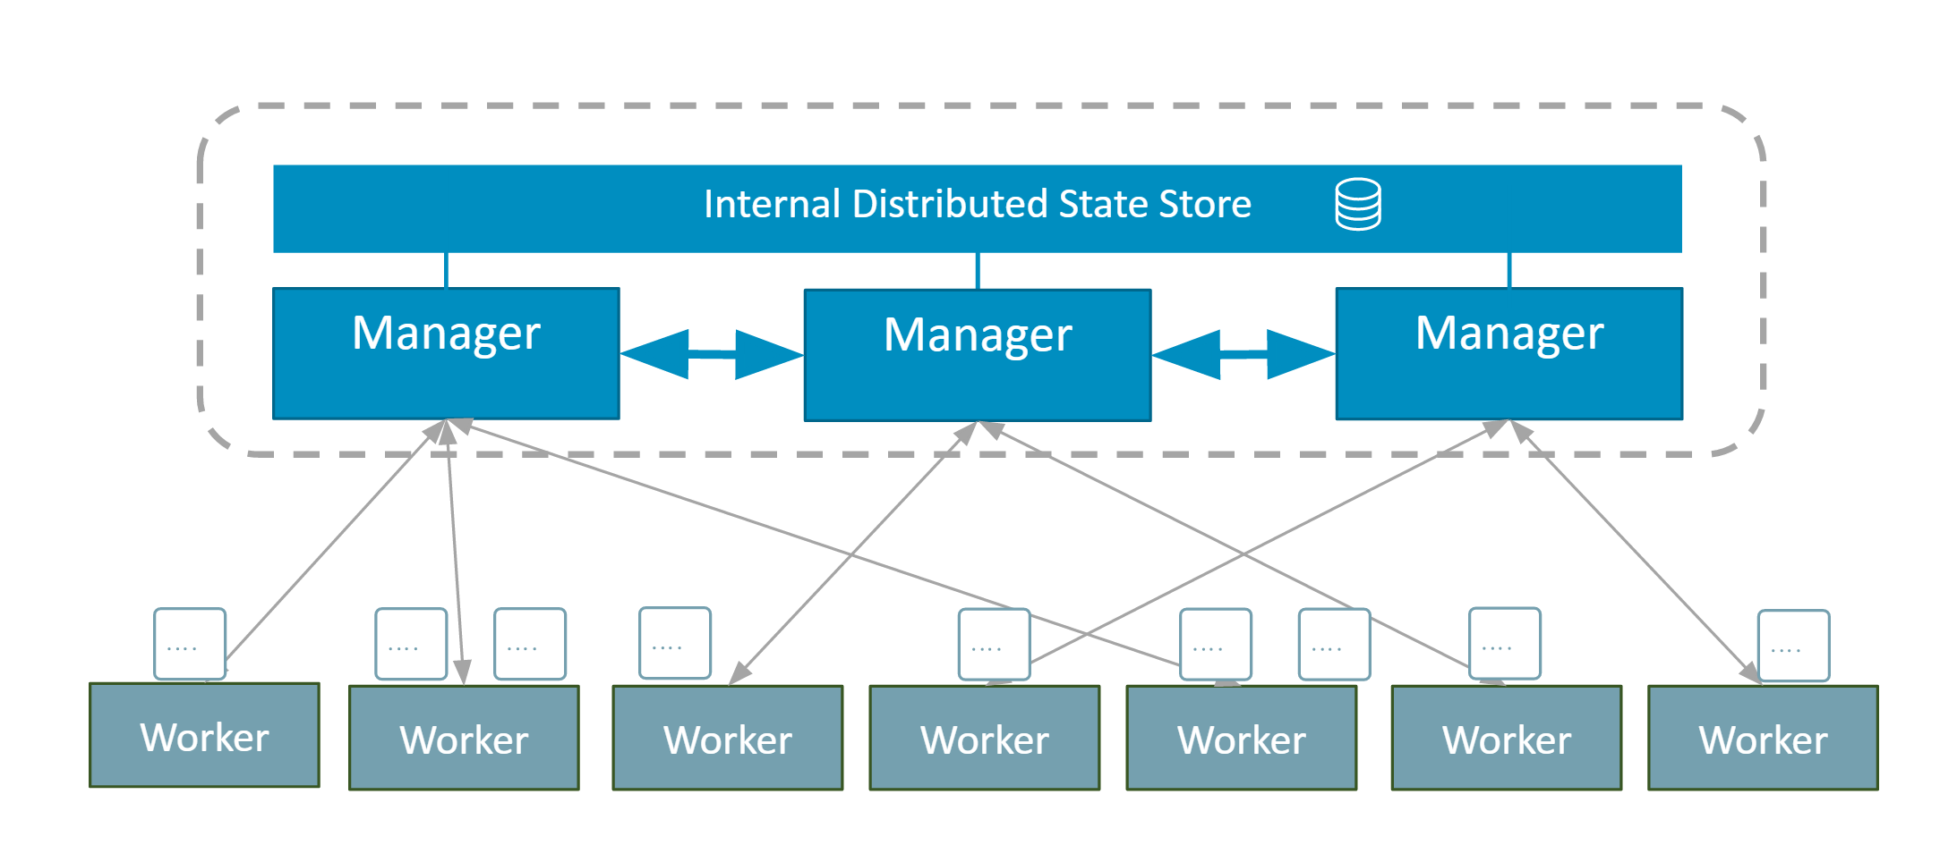
Actors in Orchestrators
Every orchestrator has the concept of two types of nodes
Managers
Serve as the brains of the cluster
Maintain state and schedule work
Sometimes called masters
Worker nodes
Perform the actual work, as instructed by a manager
Sometimes called agents or nodes
Notes:
Managers are the brains, workers are fairly dumb/ignorant in that they only know what they’re told and are only told what they need to know

Slide 42
Different types of Orchestrators
Docker Swarm
Shipped with the Docker engine
Very user friendly and easy to get up and running
Satisfies most needs, though not all; theoretically extensible, but takes a little work
Currently only orchestrator to run on both Linux and Windows nodes*
Kubernetes
Spun out of work done within Google and contributed to CNCF
Think of it more as a toolkit - so not as easy to get up and running
Very configurable and extensible
Amazon ECS
Made by Amazon Web Services and provided for free
Provides deep integration into other AWS resources (IAM, ALBs, Auto-scaling, etc.)
* Kubernetes can run on Windows when using Docker EE
Notes:
Each cloud provider has their own Kubernetes service

Slide 43
That’s it! (Phew!)

Slide 44
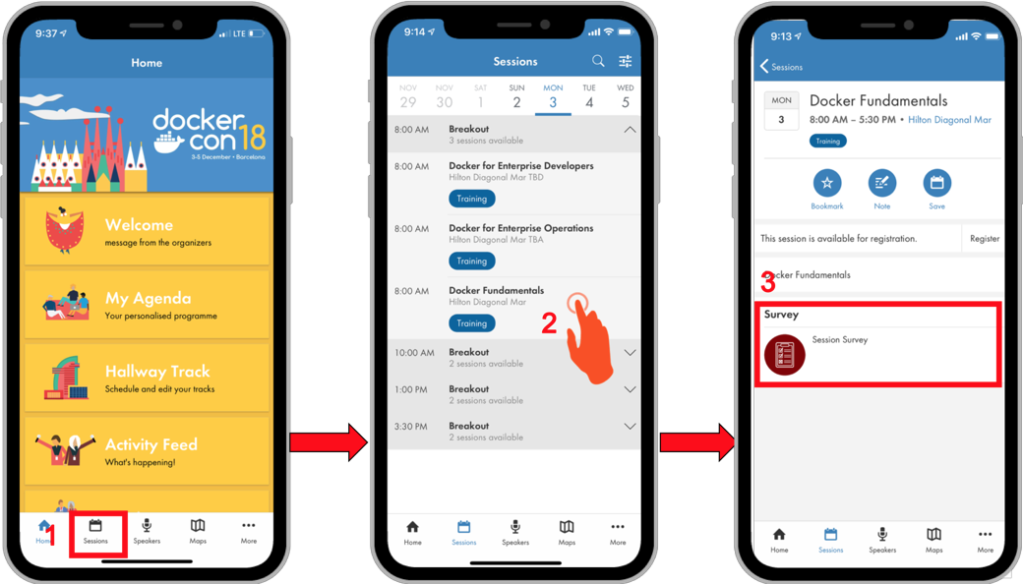
Take A Breakout Survey
Access your session and/or workshop surveys for the conference at any time by tapping the Sessions link on the navigation menu or block on the home screen.
Find the session/workshop you attended and tap on it to view the session details. On this page, you will find a link to the survey.

